Slide 1
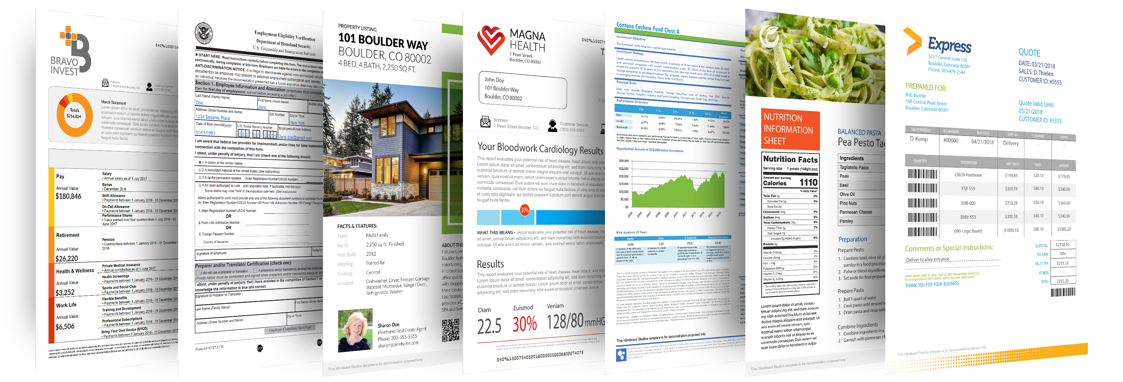
The Document Automation Experts

Slide 2
WHO WE ARE
Windward introduced an easy-to-use, superior quality enterprise reporting & document automation software in 2002. The goal to create a product that made it easy for non-programmers to design report templates - without sacrificing power and performance – remains our focus today.
Windward's customer base spans 70 countries and includes more than a thousand customers ranging from small businesses to the Fortune 100 to government agencies.

Slide 3
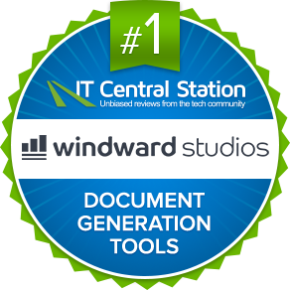
WHAT WE DO
Customized Document Automation
Windward Studios leads the industry in data-powered reporting and document generation. We enable our customers to create visually dynamic documents that look precisely the way they want without the painful hassle and long timelines of legacy and alternative solutions.
As a result of the intuitive functionality and dramatic time savings, companies can SIGNFICANTLY reduce their costs of tools, time, and labor, freeing up internal resources & budgets to be invested in other important company initiatives.

Slide 4
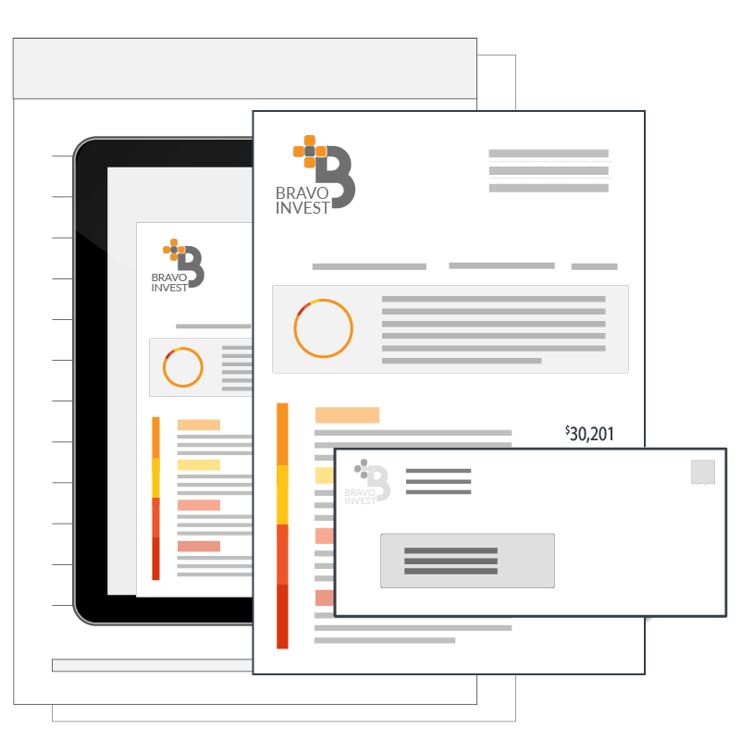
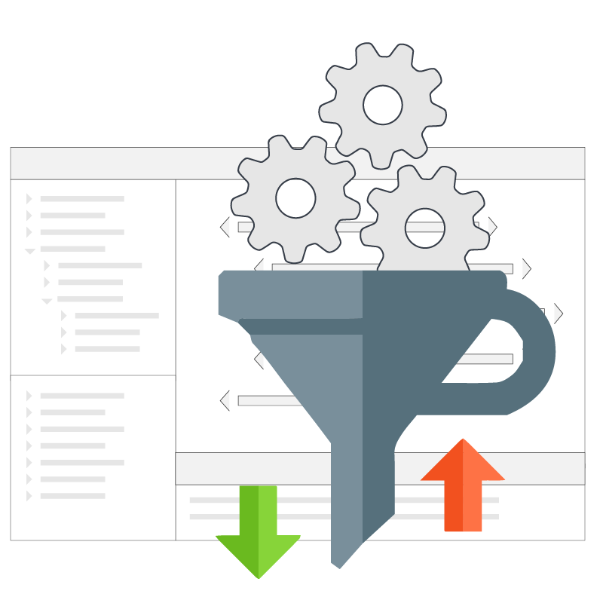
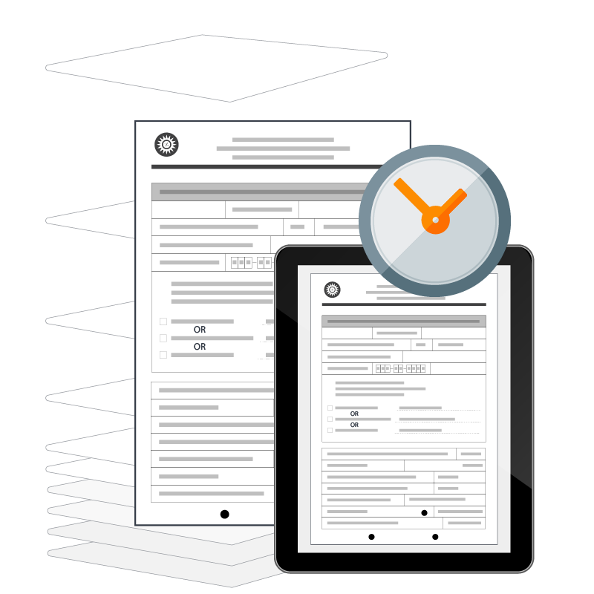
WHY WINDWARD?
Visually Stunning Designs
Our platform provides all the capabilities and tools to create incredibly beautiful layouts and eye-catching designs. The only limit is your imagination.
Smart Document Logic
You can customize your document content and format "on-the-fly" so you can automatically create documents tailored for any audience from just one template.
Massive Time Savings
With Windward’s solution, you can design templates quickly (often in minutes) and don’t have to be a programmer to do it.

Slide 5
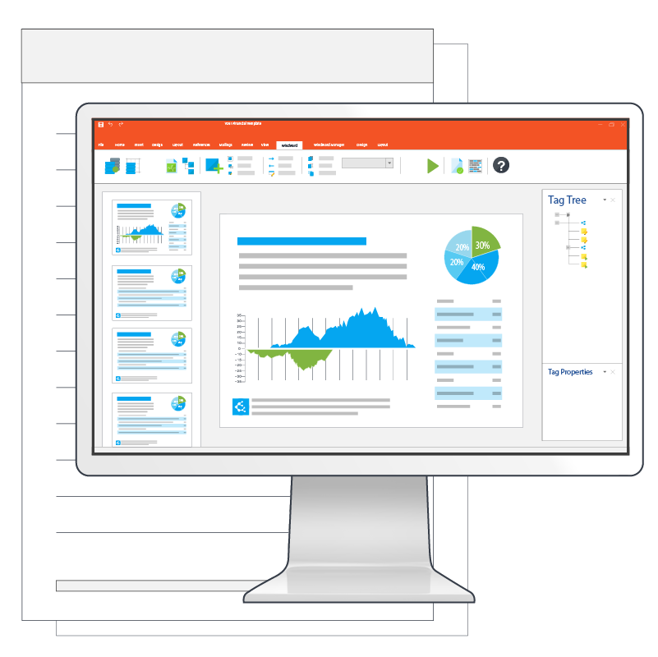
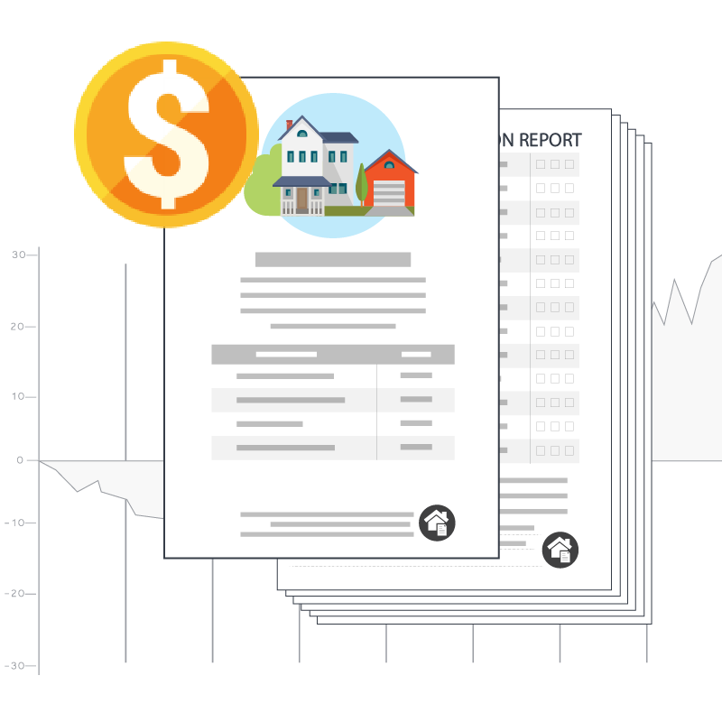
WHY WINDWARD?
Incredibly Intuitive Interface
With the ability to design, customize, and edit documents within the familiar Microsoft Office Suite, our platform is designed to make your experience frustration-free from start to finish.
Streamlined Cost Savings
From reducing resources needed for development to overall decreased developer time, we streamline your template creation and document automation process, resulting in significant time and cost savings.

Slide 6
RETURN ON INVESTMENT
ROI
{CUSTOM DETAILS HERE}

Slide 7
ROAD MAP
Cloud Targeted Enhancements
RESTful Engine: SaaS Offering
Integrated into Workflow Systems
Pre-packaged RESTful Engine
AWS
Azure
Salesforce
Platform Agnostic
Power Platform Custom Connector

Slide 8
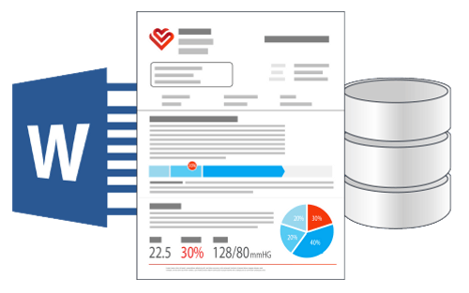
STEP 1
HOW IT WORKS
Design Your Smart Documents
Connect one or multiple data sources to your DOCX, XLSX, or PPTX template
Design your template within Microsoft Office (Word, Excel, or PowerPoint)
Use the full power of Office for layout & formatting
Use conditional logic to customize your content inline creating a smart document

Slide 9
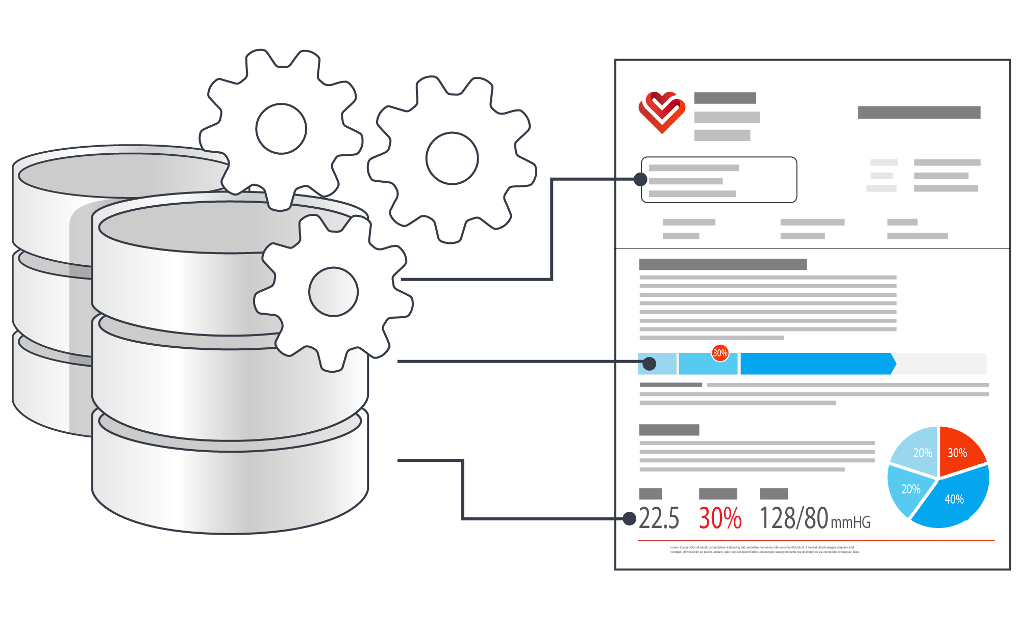
STEP 2
HOW IT WORKS
The Powerful Engine Processes Your Data
Add the engine library to your application (Java: link to JAR files, .NET: add DLLs as resources, RESTful install an ASP.NET web app)
Instantiate a Report object, pass it the template, data source(s) and output destination
The powerful Windward Engine merges your template with your data creating the output document/report.

Slide 10
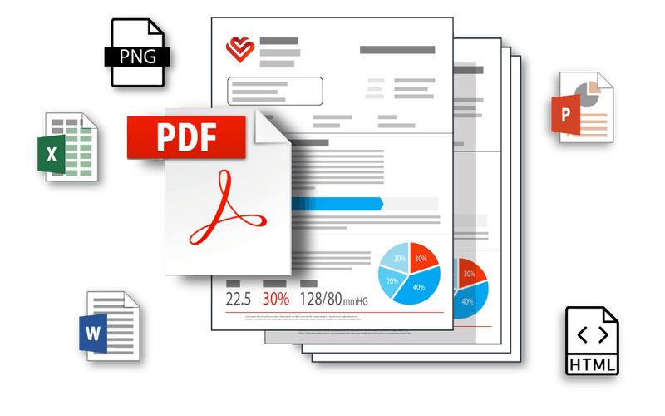
STEP 3
HOW IT WORKS
Generate Your Output
Generate your document/report to a wide variety of output formats: DOCX, XLSX, PPTX, PDF, HTML, and many more.

Slide 11
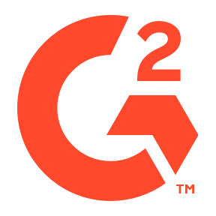
#1
#1
Document Generation
4.75 stars
Documentation Generation Software
5 stars
Document Generation
Document Generation
#3
4.8 rating
#1
8.8 rating
Reporting Tools
Reporting Tools
4.8 rating
+Top Alternative to Competitors
8.8 rating
Document Generation
4.5 stars
#1
Document Generation
4.5 stars
#1
#4
Document Creation
8.6 rating

Slide 12
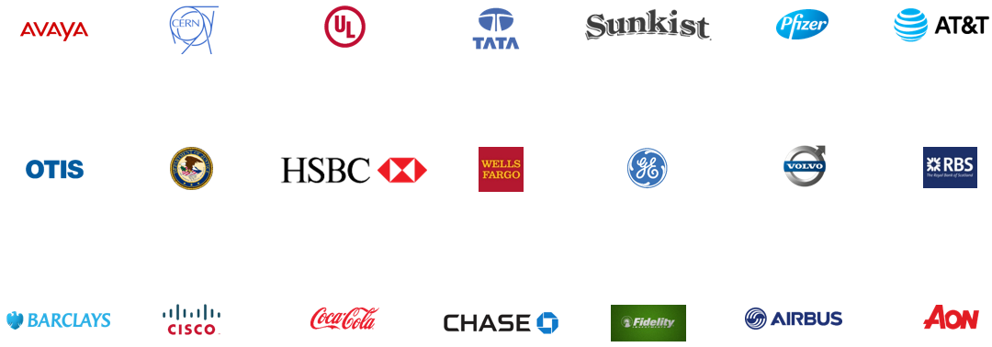
Windward Select Customers

